Slide 1



SAYALI KUMAR
7/6/2025

Slide 2
Problem Statements
1. Total Number of Unique customers across various regions and Gender distribution across each region.
2. Gender distribution in percent among overall number of customers.
3. Average Balance based on Job Classification
4. Average balance based on age range
5. Trend for the number of new customers on boarded each month of 2015
6. Find the two top most customers based on the sum of the balance they have in the account

Slide 3
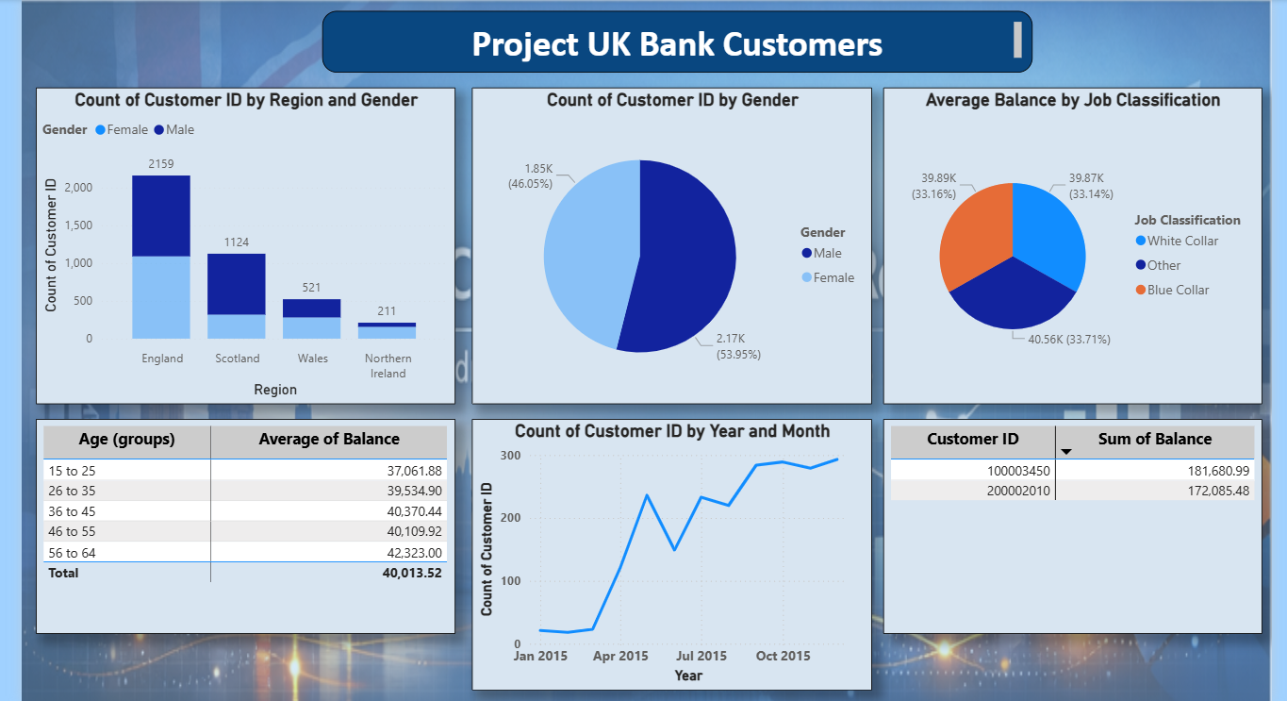

Slide 4
Title: UK Bank Customers – Power BI Report
This presentation provides a data-driven overview of UK bank customers, prepared and visualized using Power BI. The report highlights customer demographics, banking behaviors, and key performance indicators relevant to financial institutions.
The slides are designed to:
Showcase interactive dashboards and visualizations.
Present customer segmentation and trends.
Support data-driven decision-making for banking strategies.
Provide a clear, professional view of customer data for analysis and reporting.

